Slide 1
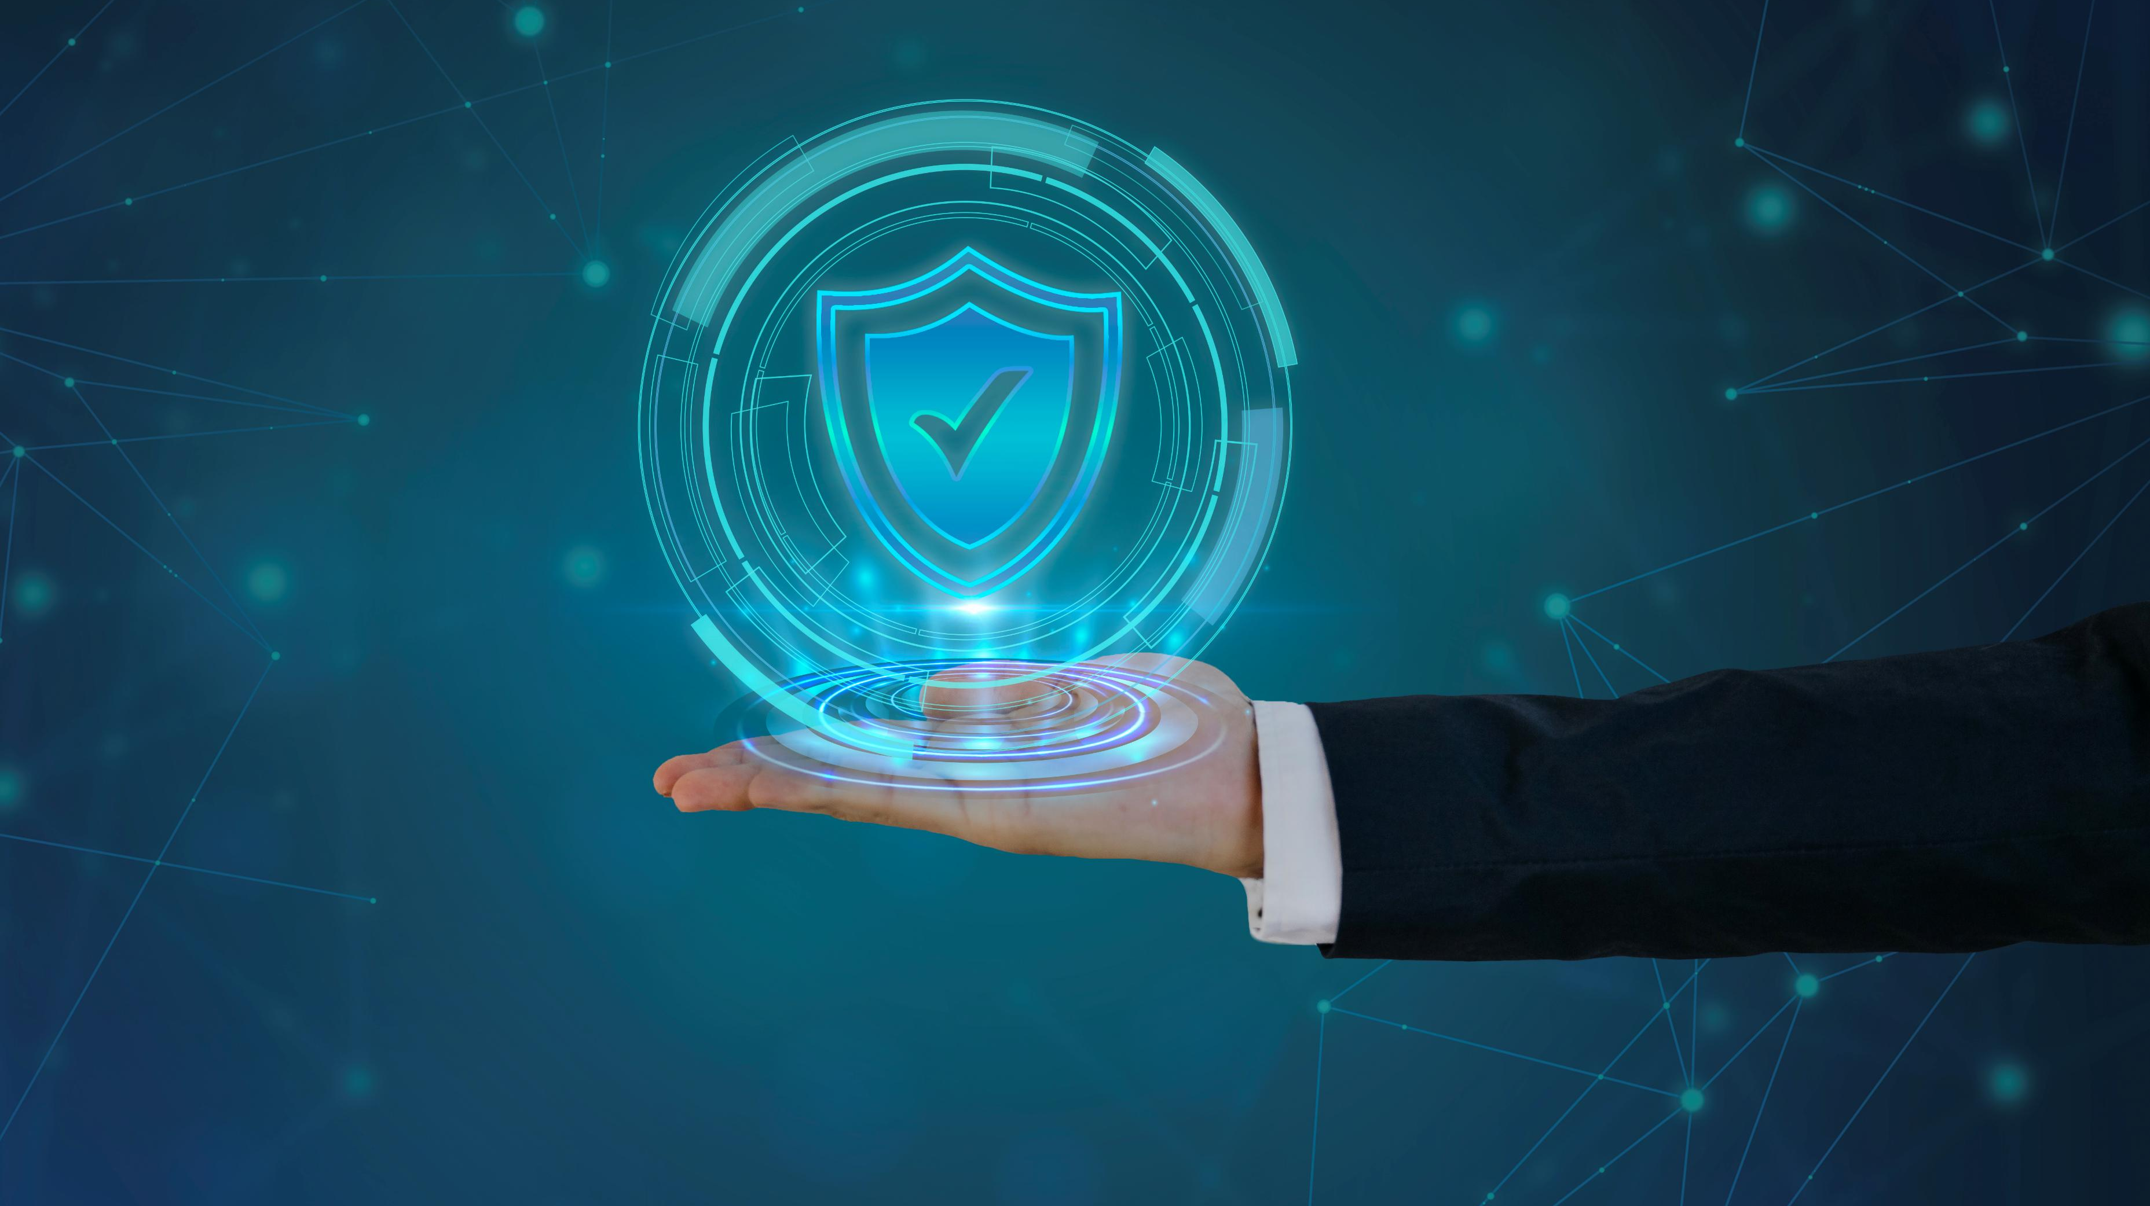
Defend Together: Building a Cyber-Secure Workplace
Team Members:
Kajan S
Kezotharan G
Noel K
Farhan R
Awareness Meeting
11/04/2025

Slide 2

Thank You for Your Support
Message from team:
“We sincerely appreciate your support in completing the cybersecurity assessment and for accepting this awareness session. Together, we’re taking an important step toward a safer digital future.”
Notes:
Thank you again for supporting this assessment, and for joining today’s session. Let’s continue working together to keep Jungle Kitchen secure. If you have any questions or concerns, feel free to reach out to me or our designated contact. Thanks again!

Slide 3

Why Cybersecurity Matters ?
We're adopting more digital tools — that means more responsibility
Cybersecurity affects operations, trust, and growth
Everyone plays a role in protecting our digital space
Notes:
“As we embrace digital tools like cloud storage, email, and online payments, we also increase our exposure to cybersecurity threats. These threats aren't just aimed at large corporations anymore—small and medium-sized businesses like ours are actually being targeted more than ever. A single incident could lead to data loss, business interruption, or damage to customer trust. That’s why cybersecurity must be taken seriously by every one of us.”

Slide 4
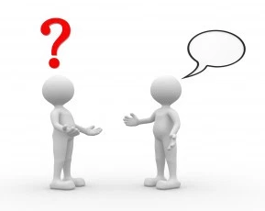
Why It’s Urgent – Real Incidents
Real Cybersecurity Threats Facing Businesses Like yours
Phishing scams cost SMEs thousands.
No MFA led to breach in a logistics firm in Singapore.
Websites like Wix were targeted in payment fraud campaigns.
A Sri Lankan startup lost 6 months of data due to poor backup strategy.
If it happened to them, it could happen to us.
Notes:
“To give you some real-world context, here are just a few recent examples: Earlier this year, a bakery chain in Australia lost over $20,000 due to a phishing scam that compromised their cloud-based invoices. In Singapore, a small logistics firm was breached because they didn’t have multi-factor authentication enabled—just like us. And websites using platforms like Wix, just like ours, were part of a card-skimming campaign that compromised customer payment info. One of the most painful stories—a startup in Sri Lanka lost six months of data because their only cloud backup was corrupted during a ransomware attack. These are clear warnings that what we’re doing now is not just proactive—it’s necessary.

Slide 5

What We’re Protecting – Our Digital Assets
Your Key Digital Assets
Google Drive
Company laptops & staff BYOD devices
Wix website & payment portal
Gmail accounts
Cloud backups
These are what attackers target — and what we must protect.
Notes:
“So, what are we trying to protect? These are our most critical digital assets: Our Google Drive, which stores business and staff-related documents. Laptops and personal devices we use every day for work. Our Gmail accounts and online communications. Our website and payment portal on Wix. And of course, our cloud-based backups, which we rely on if anything ever goes wrong. These tools make our operations efficient—but if compromised, they can also become points of failure.”

Slide 6
Top Cyber Risks Most of Industries Face Today
Risk can never be eliminated, so it must be MANAGED !
No MFA = Easy access to sensitive accounts
No encryption = Exposed data
Lack of training = Phishing danger
Website managed by third party = Potential backdoor
Single backup = High risk of permanent data loss
Notes:
“Our assessment identified some key risks: We don’t have MFA set up across all systems, which makes unauthorized access much easier. Our data isn’t encrypted, meaning it could be read or stolen if intercepted. Many of us haven’t had training in how to spot phishing attempts. Our website is managed externally, which means we don’t have full control. And our backup is only stored in one place—so if that goes down, we’re in trouble. All of these issues increase our exposure to cyber threats.”

Slide 7
Security Improvements
MFA roll-out on email and cloud tools
Training program initiation
Policy development and role-based access
Website audit and device encryption
Backup diversification and recovery testing
Notes:
The good news is that we’re already taking action. We’re enabling multi-factor authentication across Gmail, Drive, and the website. We’re rolling out a staff cybersecurity training program soon. We’re tightening access control and starting formal security policies. We’re reviewing our website security, and we’re setting up a second encrypted backup with regular testing. These are practical, cost-effective steps tailored for a company our size.”

Slide 8

What You Can Do
How YOU Can Protect your Assets
Use strong, unique passwords
Watch out for phishing attempts
Use work devices responsibly
Report lost devices or unusual behavior
Attend regular training sessions
Notes:
“Now let’s talk about what you can do to help. Use strong passwords—and never reuse them across accounts. Be careful with unexpected emails or links, especially ones asking for passwords or payment info. Use approved devices and apps for work purposes only. If you lose your device or notice anything strange—report it right away. And finally, please participate in the upcoming training sessions. These are designed to help you spot and prevent attacks before they happen.”

Slide 9

Let’s Stay Cyber-Safe Together
“Cybersecurity is everyone’s responsibility. Your daily actions matter.”
Thank you again for supporting this journey and attending this session
Notes:
“To close things out, I just want to remind everyone—cybersecurity isn’t just the responsibility of the IT team or leadership. It’s something we all play a role in every single day. Even small actions—like reporting a suspicious email or locking your laptop—can make a huge difference. Thank you again for supporting this assessment, and for joining today’s session. Let’s continue working together to keep Jungle Kitchen secure. If you have any questions or concerns, feel free to reach out to me or our designated contact. Thanks again!

